Slide 1


Team ORCABOX
Delivering Visually Accessible Web Browser Experiences Through AI
Microsoft Intern Coding Jam Summer 2023

Slide 2
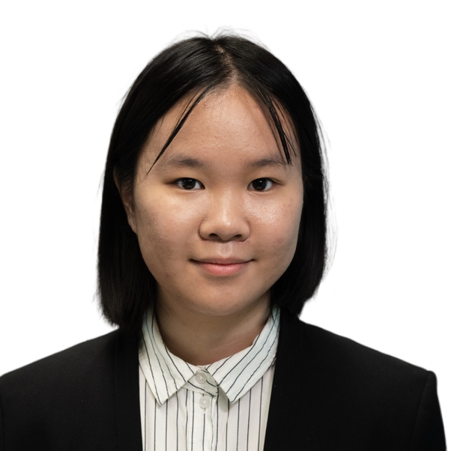
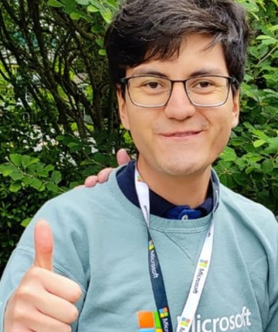
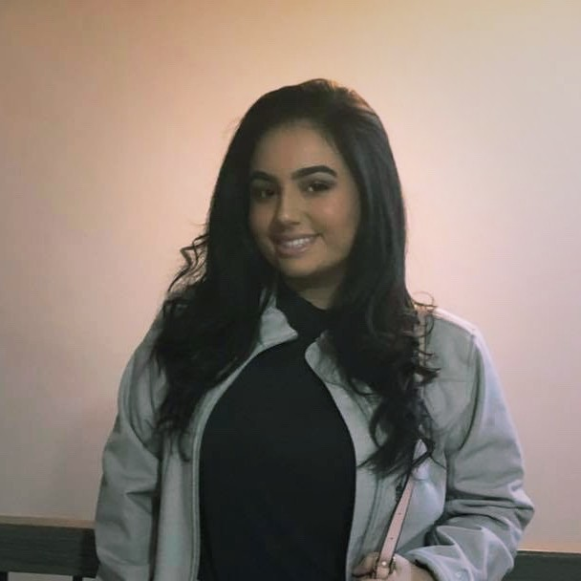
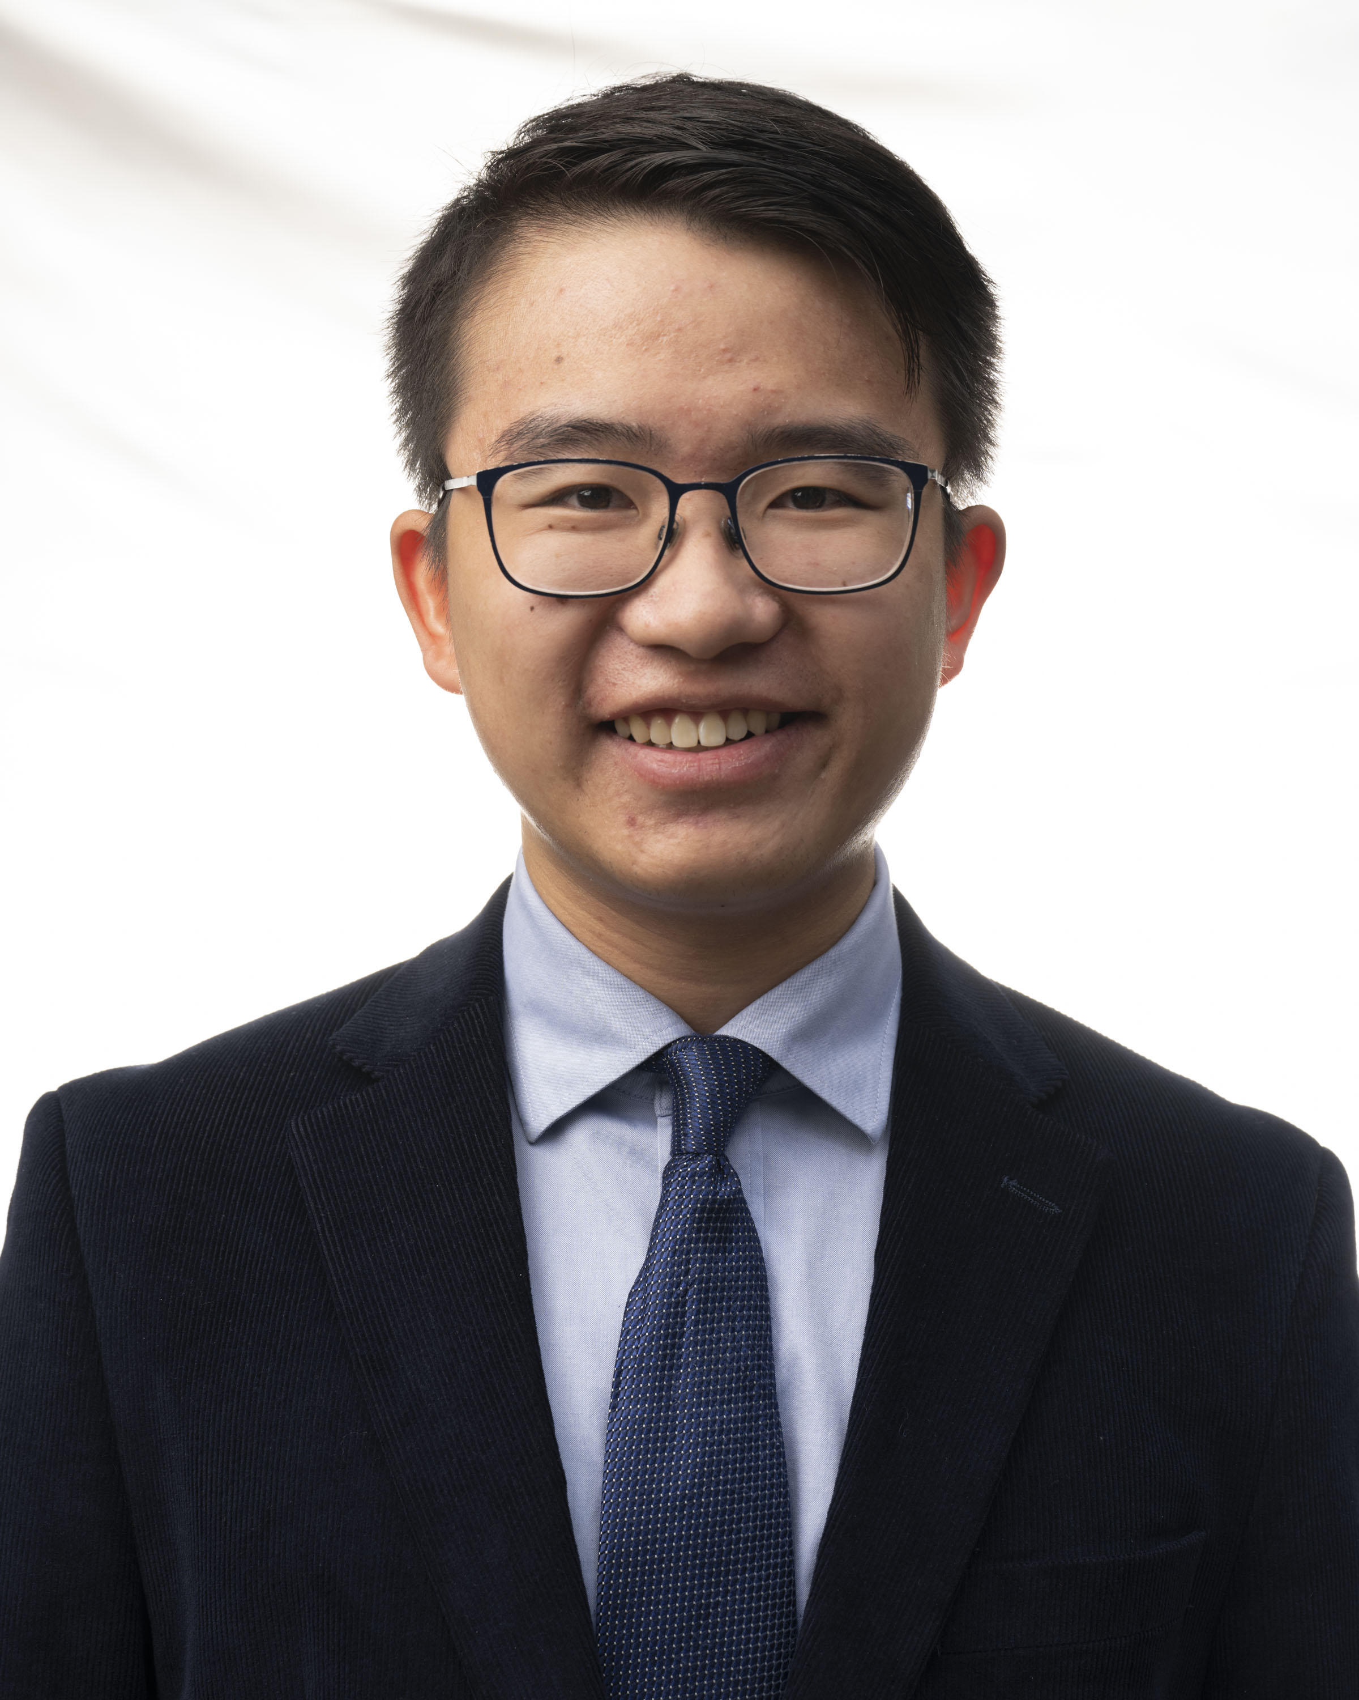
Our Team
Sofia Yang
Fredin Vazquez
Hadeel Ali
William Tom
She/Her
He/Him
She/Her
He/Him
Xbox
Xbox
Customer Service
& Support (CSS)
Azure Hardware Systems & Infrastructure (AHSI)
- Sofia is a rising junior at Illinois Institute of Technology, majoring in Computer Engineering / Economics.
- Sofia has 5 Azure Certifications and participated in 8 OpenHacks in Microsoft prior to entering college.
- In her free time, she enjoys competitive programming and contributed to the 'AI For Orcas' project as a programmer/Azure specialist from Sep 2021.
- Sofia is also an 2023 Motorola Solutions Scholarship awardee.
- Fredin is a rising 3rd year computer engineering student from Mexico City, Mexico.
- He is interested in exploring other fields in Data Science and enjoys participating in programming contests such as ICPC or hackathons.
- In his free time, Fredin likes to create 3D animations on Blender, draw his own characters, and play video games.
- He is always eager to learn about new technologies.
- Hadeel is a rising senior Math and Stats student from McMaster University in Canada.
- She is a campus representative to connect Math students with the tech industry.
- Hadeel has worked as an R&D intern at a start-up company led by physicists and has also worked at IBM and Microsoft.
- Her hobbies include gaming, cooking, going to the gym, watching Anime, and reading.
- William is a rising 5th year computer engineering student at RIT, originally from Brooklyn, NY.
- He has previous co-op/internship experiences at Emerson, Northrop Grumman, and AMD involving data analytics & database management, embedded software development, and silicon physical design.
- In his free time, he enjoys biking, going to the gym, tinkering with and building desktop computers, playing PC games, and collecting Pokémon cards.
2

Slide 3
AGENDA
Our Team
Motivation: Technology and its Accessibility
Problem Statement
Our Solution
Impact
Implementation
3

Slide 4
Technology and its accessibility
Accessibility
Fast Facts
The use of a computer is essential for everyday life. However, it is crucial to provide accessibility to different types of users who require additional aid to achieve a more optimal use of computers.
Did you know that in 2017 the National Health Interview Survey (NHIS) established an estimated 26.9 million U.S. adults reported that they either "have trouble" seeing or that they are unable to see at all?
This does not mean they cannot make use of tools such as a computer. It is the task of programmers and product managers to create tools to provide accessibility.
Notes:
Accessibility is important

Slide 5
motivation
A SUBSTANTIAL PROPORTION OF VISUAL-BASED CONTENT ON THE WEB IS INACCESSIBLE TO USERS WITH VISUAL IMPAIRMENTS:
22%​
​
285​mil
​
The vast majority
​
People who cannot access content on websites due to lack of visual accessibility
SITES IN 2023 MISSING 'ALT' TEXT (IMAGE DESCRIPTIONS FOR SCREENREADER APPLICATIONS)
… OF VIDEOS ON THE WEB DO NOT HAVE AUDIO DESCRIPTIONS FOR VISUAL ACCESSIBILITY
Notes:
A SUBSTANTIAL PROPORTION OF VISUAL-BASED CONTENT ON THE WEB IS INACCESSIBLE TO USERS WITH VISUAL IMPAIRMENTS:

Slide 6

So... Problem statement
How can we increase the accessibility of visual-based media in browsers for people with visual impairments so they can have equal access to information and experiences on the web?
The answer is easy...
Create a product, the solution.

Slide 7
Impact
The impact of this project will be to substantially improve comprehensibility of visual media. Due to our prototyped solution, the user will have detailed descriptions of images accessed, including graphics and diagrams. This empowers users to easily access any type of content, from news articles to tutorials.
Notes:
Impact: all people can access images of all types

Slide 8
That is why we present... Visionear
Our solution
Our project aims to create a browser extension that helps people with low vision by providing them with audio descriptions of images.
The extension is designed to focus on the user and make it easier to navigate through the contents of graphics, images, photographs, drawings, among others
Information of media will be better accessed and understood due to the use artificial intelligence (OpenAI) to create descriptions
Notes:
browser extension that helps people with low vision by providing them with audio descriptions of images.
We use AI.

Slide 9
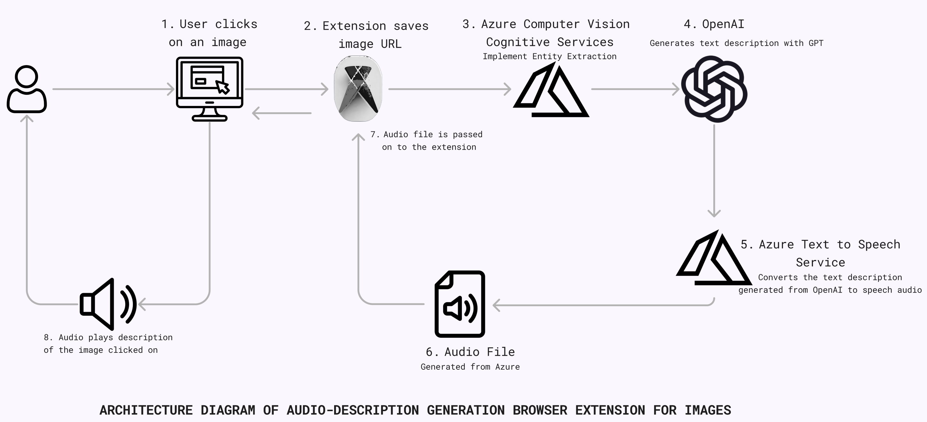
Implementation
UTILIZE CUTTING-EDGE AI TECHNOLOGIES AND CLOUD SOLUTIONS

Slide 10
Technologies
Frontend / ui
Edge.//Extensions (HTML5)
Backend services
Azure Computer vision cognitive services
Azure openai gpt cognitive services (davinci model) + SEMANTIC KERNEL
Azure speech cognitive services
DEPLOYMENT / INFRA
​
AZURE FUNCTIONS
AZURE BLOB STORAGE
Notes:
Walk through this.

Slide 11
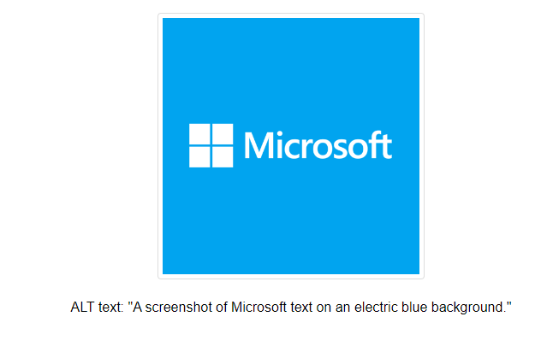
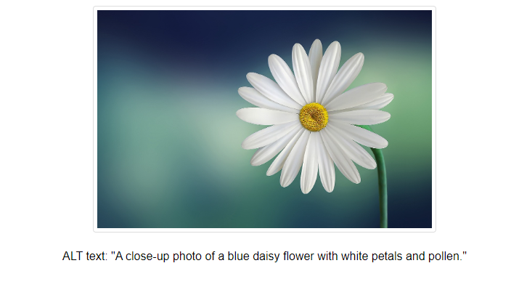
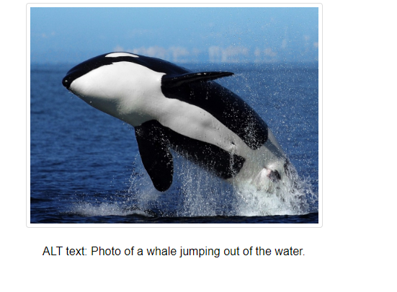
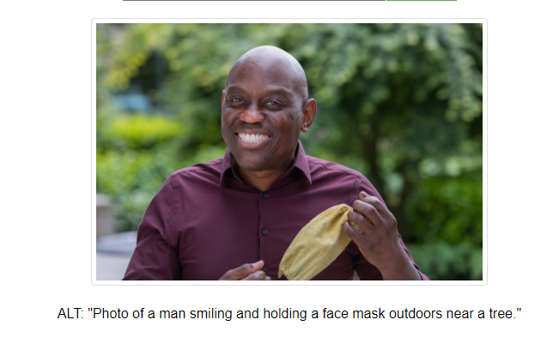
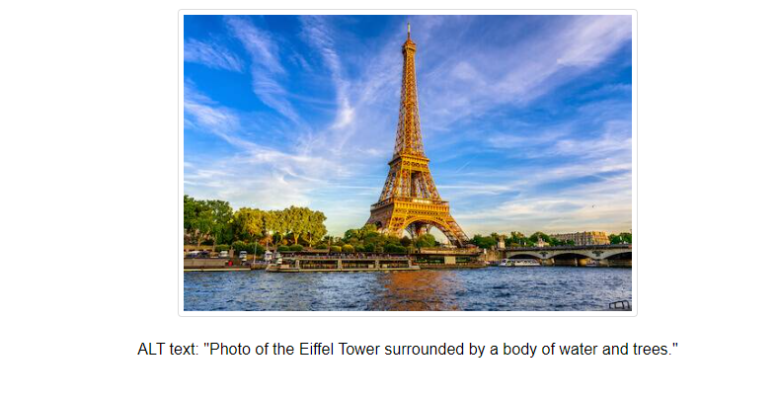
Demo (IMAGES)
Notes:
Walk through this.

Slide 12
Implementation sequence (images description)
To start, the URL of the image that the user clicked on will be obtained and stored by the extension
The 'front-end' browser extension extracts the URL of an image that the user selects.
2. The browser extension triggers a request to a Computer Vision feature.
The Computer Vision feature utilizes Cognitive Services and is deployed as an Azure Function.
Data extracted includes the following:
captions
objects
tags
ocrText
landmarks
imageType
colorScheme

Slide 13
IMPLEMENTATION SEQUENCE​ (IMAGE DESCRIPTION)
The JSON object will be sent to fetch the endpoint of the description generation service. In this case we will be using an LLM service (daVinci model) to generate a description, so we will implement a template that works as a prompt and generates the description. The endpoint will return a JSON object containing only one property, which is the generated description.​
Finally, the last endpoint to fetch is the Microsoft Cognitive Service: text to speech.
The conversion of the text to speech, with the configuration of an English speaker will be executed. ​
In this way an audio is generated using a URL.​
Next, the Azure Storage blob service will be used to load the audio.​
When the generated audios are uploaded to a unique URL, each URL is fetched and returned as the endpoint response.​
The URL is saved in a variable and then is used to generate an Audio object.​
The audio is now finally played to the user

Slide 14

VIDEO AUDIO-DESCRIPTION DEMO
Microsoft Intern Coding Jam Summer 2023

Slide 15
IMPMENTATION PROPOSAL: AUDIO-DESCRIPTIONS FOR VIDEO
Sequencing
Utilize Azure VideoIndexer to extract all keyframes of a video.
Use existing image description generation services to generate textual descriptions of keyframes.
3. Extract relevant video captions at timestamp of keyframes.
4. Use textual data from captions and description to extract insights of what is happening at each keyframe in text.
5. Convert text description of each frame to speech (mp3 format)
6. Utilize FFMPEG library to intersperse mp3 for each speech segment into the silent part of the original audio
7. Replace the original audio track with the new audio track for the video.

